Slide 1
DECENTRALIZED FINANCE
FLASH LOANS

Slide 2
FLASH LOANS - NO COLLATERALS
Is a feature that allows you to borrow an available amount of an asset from a designated smart contract pool with no collaterals.

Slide 3
BUILDING BLOCKS of DEFI
WHY?
Arbitrage
Swapping Collateral
Self Liquidation
Notes:
Flash loans are building blocks of DeFi as they can be used for thing like

Slide 4
What’s the CATCH??
A flash loan has to be borrowed and paid “within the same blockchain transaction”
Notes:
Flash loans was introduced by marble protocol and popularised by AAVE and dy/dx.
So, what’s the catch?
A flash loan has to be borrowed and paid “within the same blockchain transaction”

Slide 5
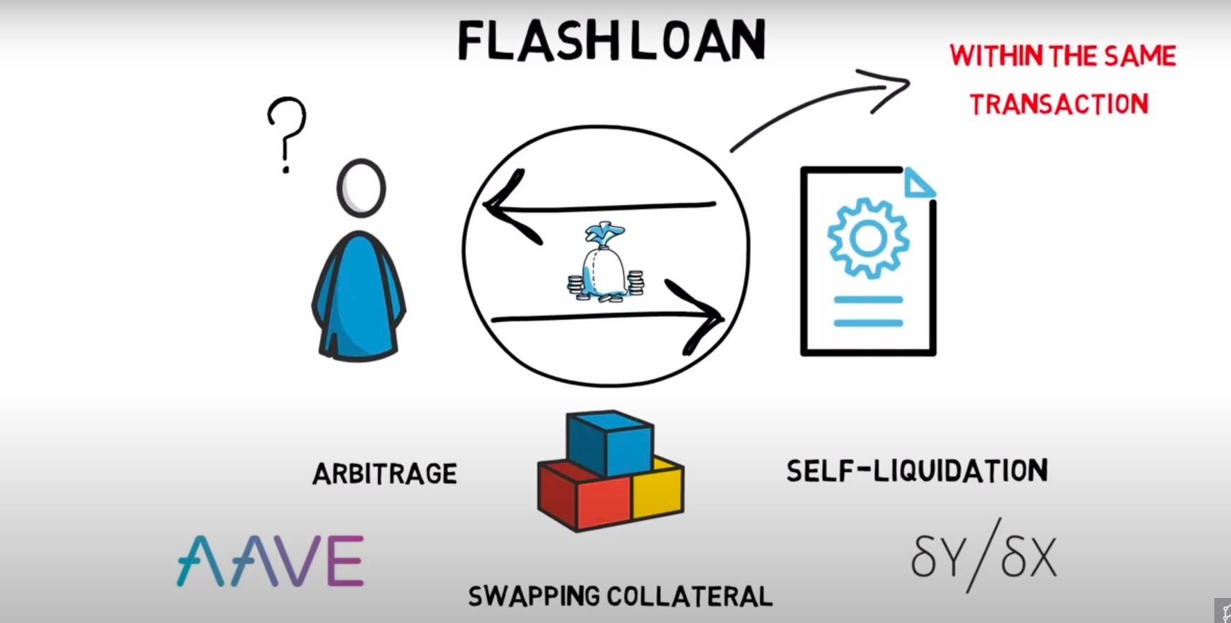

Slide 6
TRANSACTION?
A transaction represents a set of operations that must be executed in an “ATOMIC” way.
Either all the steps are executed or the transaction is rolled back and none of the steps takes place.
Notes:
A concept of transaction on a blockchain such as Ethereum is no different to the traditional definition of a transaction in computer science.
A transaction represents a set of operations that must be executed in an “ATOMIC” way.
Either all the steps are executed or the transaction is rolled back and none of the steps takes place.
Give example of database transaction of ALICE and BOB

Slide 7
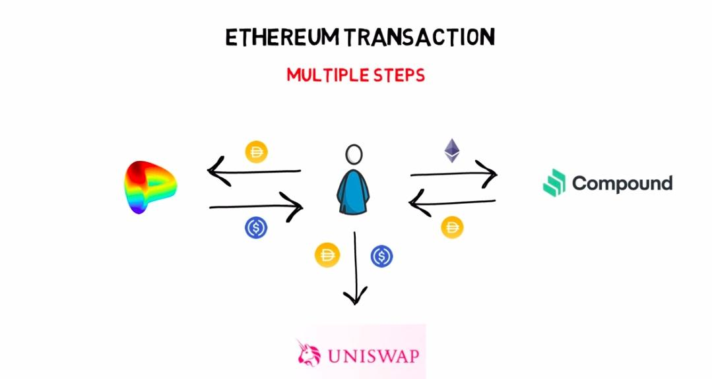

Slide 8
MULTIPLE STEPS TRANSACTION
One ETHEREUM Transaction can consists of multiple steps such as:
Supply ETH and borrowed DAI on compound,
Swap half of the borrowed DAI with USDC on Curve, and
Provide liquidity to DAI-USDC pool on UniSwap
all in one single Ethereum transaction.
Notes:
When it comes to ethereum, every common operation such as sending ETH, sending ERC20 Tokens and interacting with smart contracts are executed within a transaction scope.
Transactions are grouped together and grouped in Ethereum Blocks. We can easily see all the transactions that were included in a particular block on any block explorer such as Etherscan.
POST - Of course, if any of it’s steps results in an error, the whole transaction will be rolled back and none of these steps takes place. Remember, you will still pay GAS-FEE for failed contract executions.
The number of steps in a single transaction are bounded by gas cost. So, although, in theory you could create a valid transaction with thousands of steps. Realistically, it would be rejected because of the max gas-cost limit per block.

Slide 9
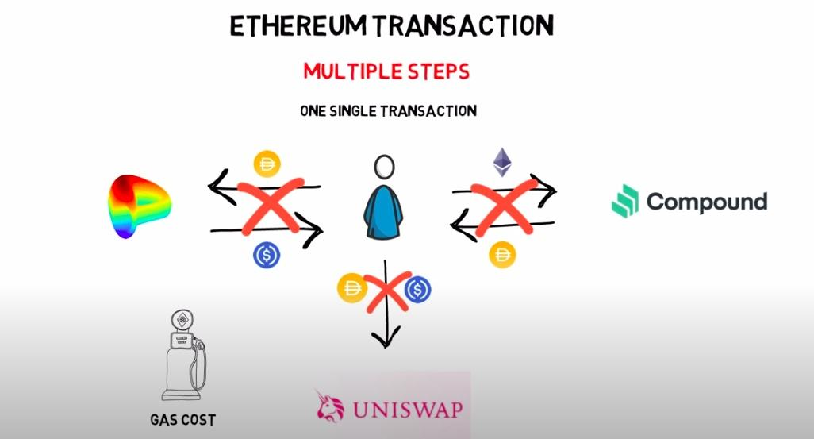

Slide 10
DEEP DIVE IN FLASH LOANS
Flash loan provider
borrow different coins from a designated pool under the condition
Condition: they are repaid within the same ethereum transaction
Fixed Cost Associated
AAVE Contract - 0.09% FEE
Notes:
First of all, the most important part of executing a flash loan is to find a Flash loan provider.Projects such as AAVE and dy/dx develop smart contracts that allow DeFi users to borrow different coins from a designated pool under the condition that they are repaid within the same ethereum transaction. There is usually a fixed cost associated with Flash loans.
AAVE contracts, for example, require a borrower to return the initial amount plus an extra 0.09% (FEE) of the borrowed amount.
The fee is split between depositors (70%), who provide the funds that can be borrowed and integrators (30%), who facilitates the use of AAVE’s flash loan API. A part of this fee is also swapped to AAVE tokens and burned.
Once the amount is borrowed from the lending pool, it can be used for other arbitrary actions assuming at the end of the chain of the different steps, the initial flash loan is repaid.
Because the loan has to be repaid within one transaction, there is no risk of borrowers not repaying the borrowed amount.
Flash loans are becoming more and more popular with some of the users borrowing as high as 14M DAI on AAVE.

Slide 11
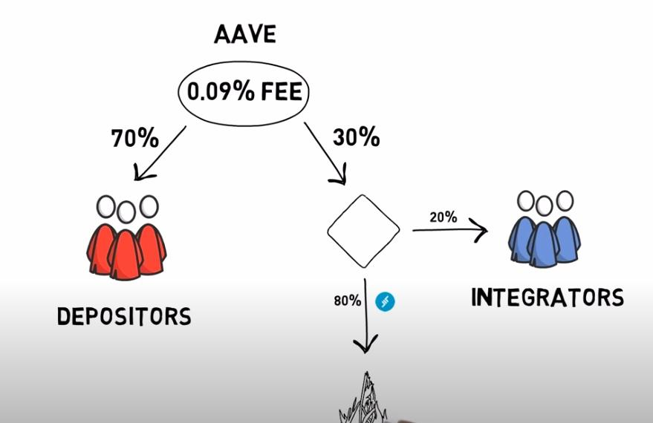

Slide 12
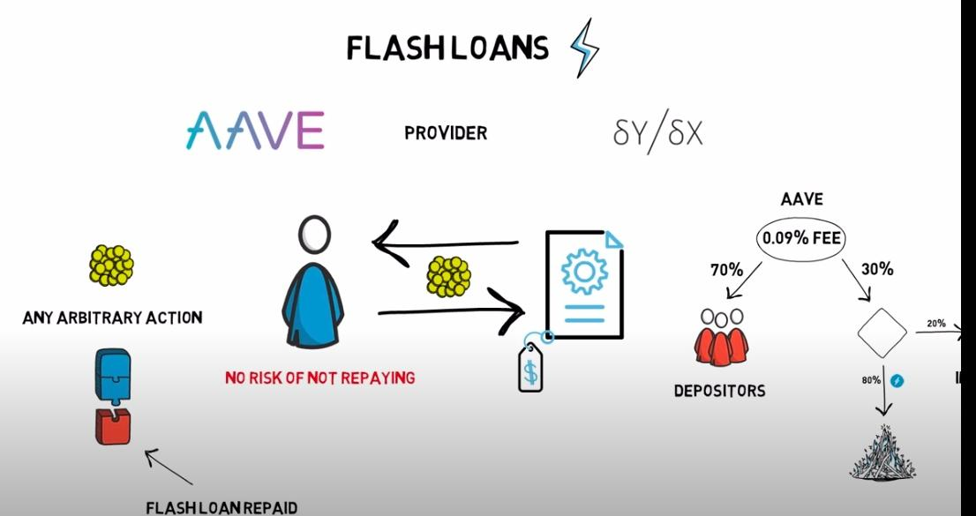

Slide 13
USE CASES
ARBITRAGE
COLLATERAL SWAP
SELF LIQUIDATION
Notes:
There are three most common use cases for Flash Loans.

Slide 14
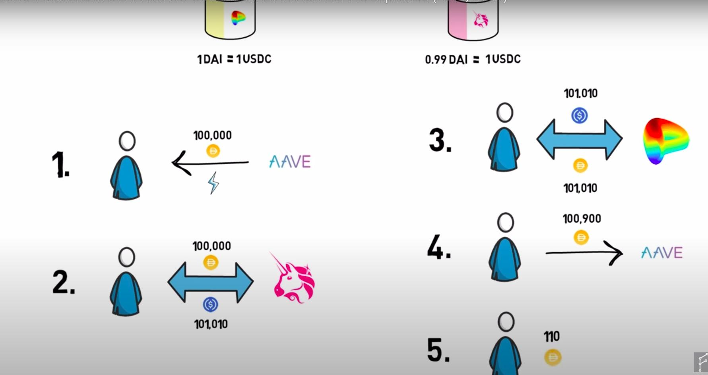
ARBITRAGE
Notes:
Flash loans can magnify the profit of executing a successful ARBITRAGE opportunity.
Let’s imagine there is a price discrepancy in the DAI-USDC pools between UniSwap and Curve. You can trade 1 DAI for 1 USDC on Curve but you need 0.99 DAI to buy 1 USDC on Uniswap.
Now you can try to execute the following arbitrage
Borrow 100000 DAI from AAVE via Flash Loans
Swap 100000 DAI for USDC on Uniswap and receive 101010 USDC
Swap 101010 USDC for 101010 DAI on Curve
Repay initial 100000 DAI plus 0.09% FEE, equals 100900 DAI to AAVE for Flash Loans
Profit = 110 DAI
THINGS TO CONSIDER
This looks nice, but we have to take few extra things into consideration:
Network FEE - Arbitrage transactions with multiple steps can be quite expensive. Always take transaction fees into account when calculating your profits.
PRICE SLIPPAGE - Always calculate how much price slippage you will experience while executing your order. A HINT - It depends on the size of your order and the liquidity present in your liquidity pool.
FRONTRUNNING - There is always a high chance that someone else will spot the same opportunity and will manage to get their transaction mined ahead of you. On top of that, BOTS that monitors the mempool can pick up your profitable arbitrage opportunity and send the same transaction with a higher gas fee profiting them instead of you. Basically, stealing your ARB opportunity.

Slide 15
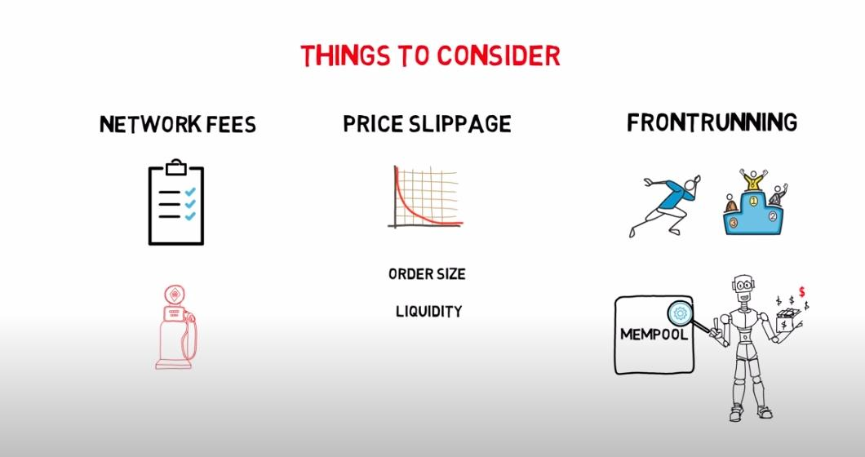
ARBITRAGE
Notes:
Flash loans can magnify the profit of executing a successful ARBITRAGE opportunity.
Let’s imagine there is a price discrepancy in the DAI-USDC pools between UniSwap and Curve. You can trade 1 DAI for 1 USDC on Curve but you need 0.99 DAI to buy 1 USDC on Uniswap.
Now you can try to execute the following arbitrage
Borrow 100000 DAI from AAVE via Flash Loans
Swap 100000 DAI for USDC on Uniswap and receive 101010 USDC
Swap 101010 USDC for 101010 DAI on Curve
Repay initial 100000 DAI plus 0.09% FEE, equals 100900 DAI to AAVE for Flash Loans
Profit = 110 DAI
THINGS TO CONSIDER
This looks nice, but we have to take few extra things into consideration:
Network FEE - Arbitrage transactions with multiple steps can be quite expensive. Always take transaction fees into account when calculating your profits.
PRICE SLIPPAGE - Always calculate how much price slippage you will experience while executing your order. A HINT - It depends on the size of your order and the liquidity present in your liquidity pool.
FRONTRUNNING - There is always a high chance that someone else will spot the same opportunity and will manage to get their transaction mined ahead of you. On top of that, BOTS that monitors the mempool can pick up your profitable arbitrage opportunity and send the same transaction with a higher gas fee profiting them instead of you. Basically, stealing your ARB opportunity.

Slide 16
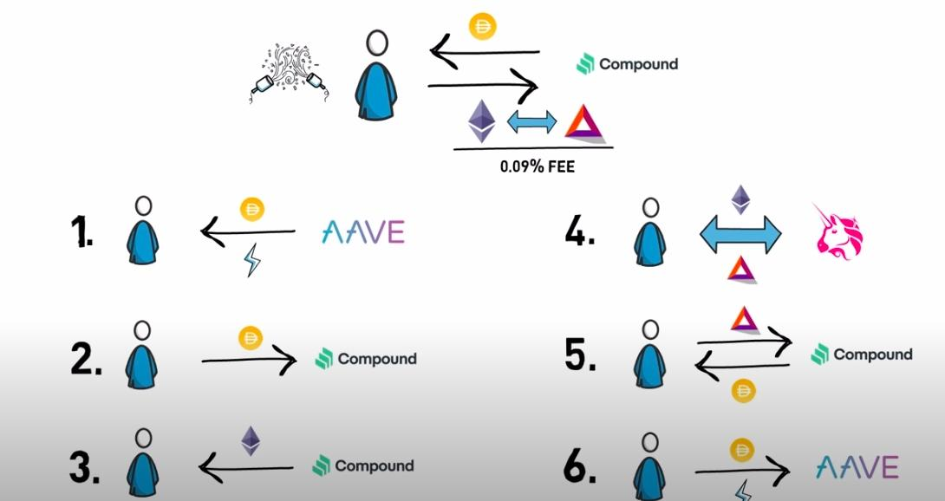
Notes:
2. COLLATERAL SWAP - Let’s say you have borrowed DAI from Compound with ETH as collateral.
You can swap your collateral, ETH to BAT, in the following order:
Take a FLASH LOAN in DAI to cover the amount of DAI that was borrowed
Repay your compound loan with borrowed DAI
Withdraw your ETH
Swap your ETH with BAT on Uniswap
Supply BAT as collateral on Compound, borrow DAI against your BAT collateral
Repay Flash loans with borrowed DAI with flash loan Fees
Congrats, you just swapped your collateral from ETH to BAT and paid 0.09% FEE of the borrowed amount for this.

Slide 17
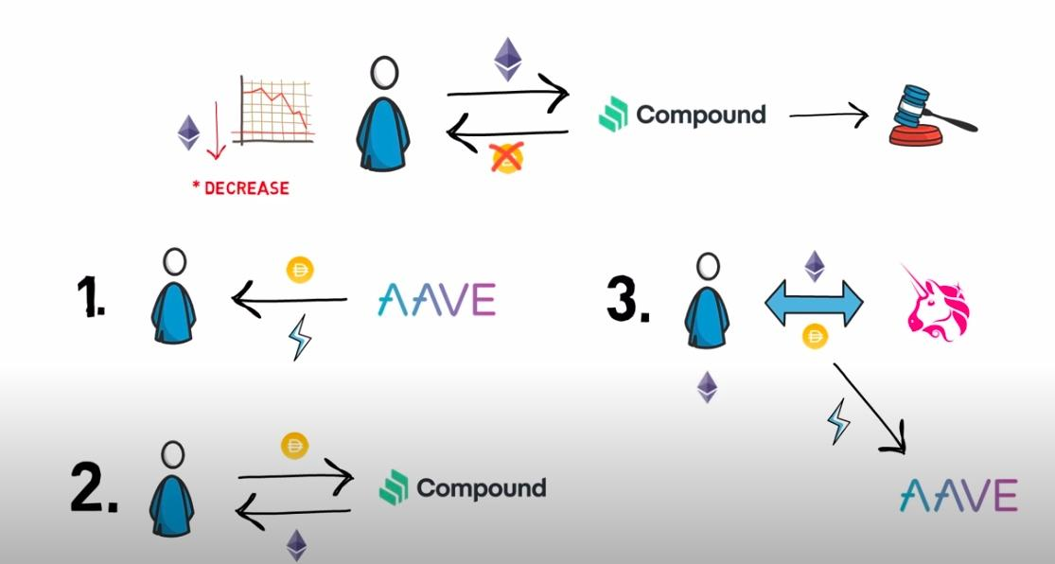
Notes:
SELF-LIQUIDATION - Imagine the following scenario:
You have a loan in DAI from Compound with ETH as collateral. The ETH price keeps going down and you are approaching the liquidation level. You also don’t have to and don’t want to deposit more ETH to increase your liquidation level and you also don’t have the DAI required to repay the loan.
Now, instead of allowing MakerDAO Contract to liquidate your collateral and charge you the liquidation fee, you can take following steps:
Take a flash loan for the amount of DAI you owe
Repay your DAI loan and withdraw your ETH
Swap enough ETH to DAI in order to repay the flash loans + fees, keep the rest of ETH

Slide 18
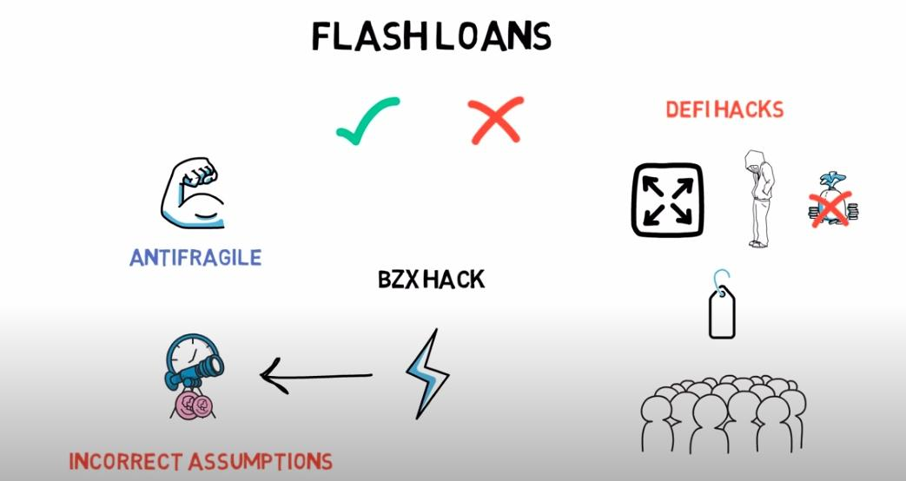
Notes:
These were the three most common applications of FLASH LOANS. Of Course, the concept of Flash Loans is quite new and there are still a lot of use cases to be discovered in future.
FLASH LOANS
Flash loans, similar to crypto can be used for both, good or bad.
When it comes to the latter, flash loans were used in most of the recent DeFi hacks and allow hackers to magnify their potential profit as they do not require any upfront funds.
One of the most famous hacks was the BZX hack where the flash loan was used to manipulate the UniSwap Oracle price. As usual, the problem was not in the use of flash loans but rather in some incorrect assumptions when it comes to using UniSwap as a price Oracle. Events like this are sometimes costly for the people affected by them. But then, they are usually resolved in the strengthening of the whole DeFi ecosystem, making it more and more anti-fragile in the future.
Although flash loans are predominantly used by developers, it is also possible to use them without doing any coding. Projects such as CollateralSwap, DeFiSaver or FuruCombo make it possible.

